Slide 1
NYC Housing Data
Colton Albin

Slide 2
Areas of Observation
Rent vs. Own:
Broken down by Boroughs
Equipment breakdowns
Overall Conditions of building

Slide 3
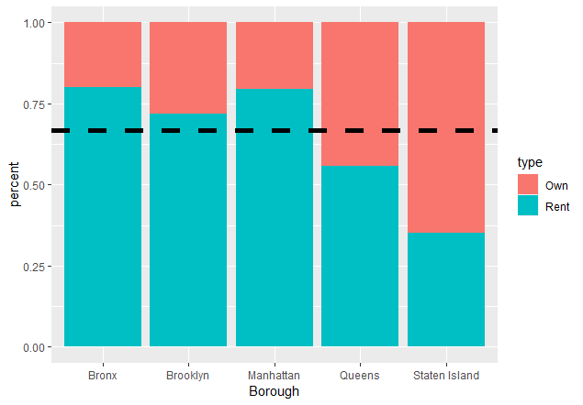
Staten Island housing market is dominated by owners rather than renters
Notes:
Queens heavily populated yet lower percentage of renting
Staten Island smallest with decent sized land area. More owning

Slide 4
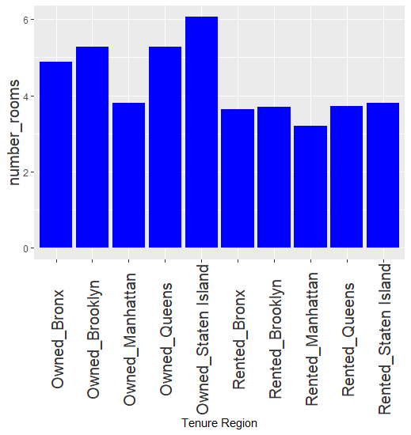
Number of rooms
Notes:
Staten Island has highest average number of rooms for owned places.
Rented Manhattan has smallest considering population size and it being the business district

Slide 5
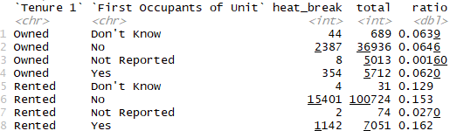
Heating Breakdowns
Notes:
Either first occupant and newly built
Or first occupant for a long time with dilapidated building

Slide 6
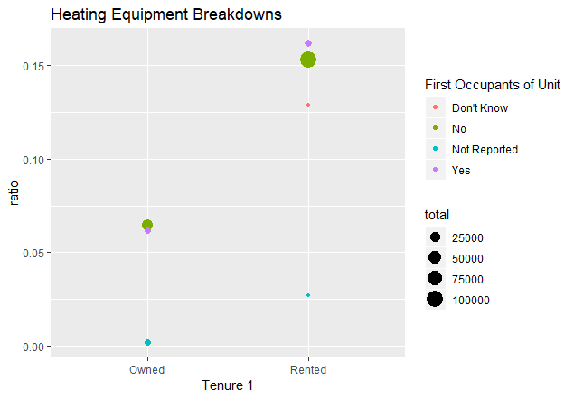
Heating equipment breakdowns occur more frequently in rented buildings

Slide 7
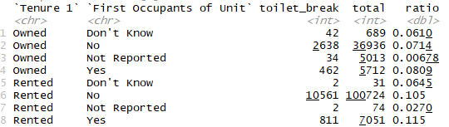
Toilet Breakdowns

Slide 8
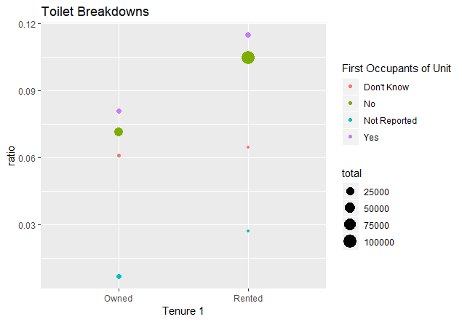
Toilet breakdowns are higher for first occupants

Slide 9
Conclusion
Research other living conditions
Build a model
Use model to predict tenure of NYC districts

